Slide 1
Module Group Project IMDCGD111-16YRD Module managing games production imdcgd214-16yrd level 4/5 Group 13 Eat them
Heidi Falcon - George Flude - Macaulay Mills

Slide 2
Logline
Players aim to eat bubbles while avoiding obstacles and the first one to eat their opponent, wins.

Slide 3
Target Audience
16-25 either gender. Casual gamers
Fast paced, simultaneous gameplay which allows for social fun,
http://www.eldergame.com/2008/05/define-your-target-audience/
http://serious.gameclassification.com/EN/about/bricks.html#PUBLIC

Slide 4


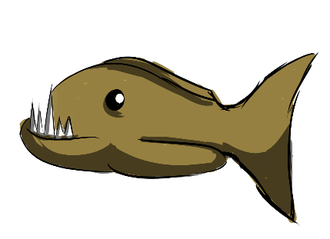




Mechanics and Assets
Game Play
Scoring
Eating/Absorbing
Strategizing
Obstacles
Branches
Fish/ Urchins

Slide 5
Research
We have researched games and took inspiration from:
http://www.ologame.com/
http://www.newgrounds.com/
http://doodlejump.org/

Slide 6
Physics
Buoyancy
Iterations
Was a game of skill
Spawning of obstacles
Grabbing mechanic, adds unpredictability
Thruster, can be improved on movement, so its not as predictable

Slide 7
Emotions
Competitiveness: Giving the winner bragging rights
Struggle: Race to gain higher score, to avoid obstacle.
Strategy: Plan to position obstacles to hinder opponent.
Aggressiveness: Game requires players to concentrate on attacking as well as defending their environment.

Slide 8
Game Specifics
Bragging Rights
Unlimited supply of items
Race to use the item
Conflict/ Rivalry
Players can bump the obstacles

Slide 9





Theme
Bubbles and underwater scenes
Solid Colours

Slide 10
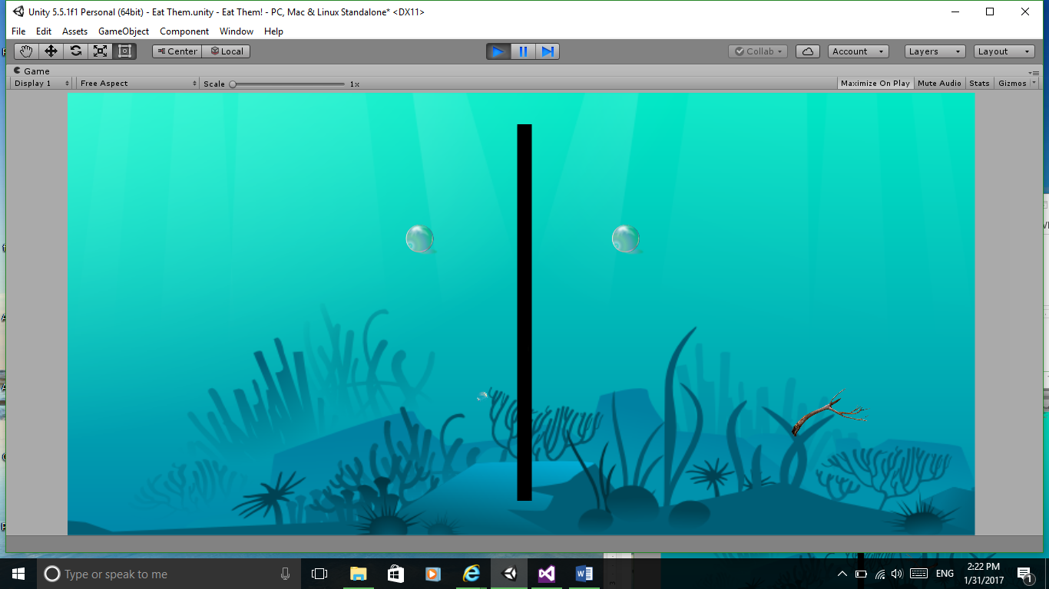
Prototype Screen 1

Slide 11
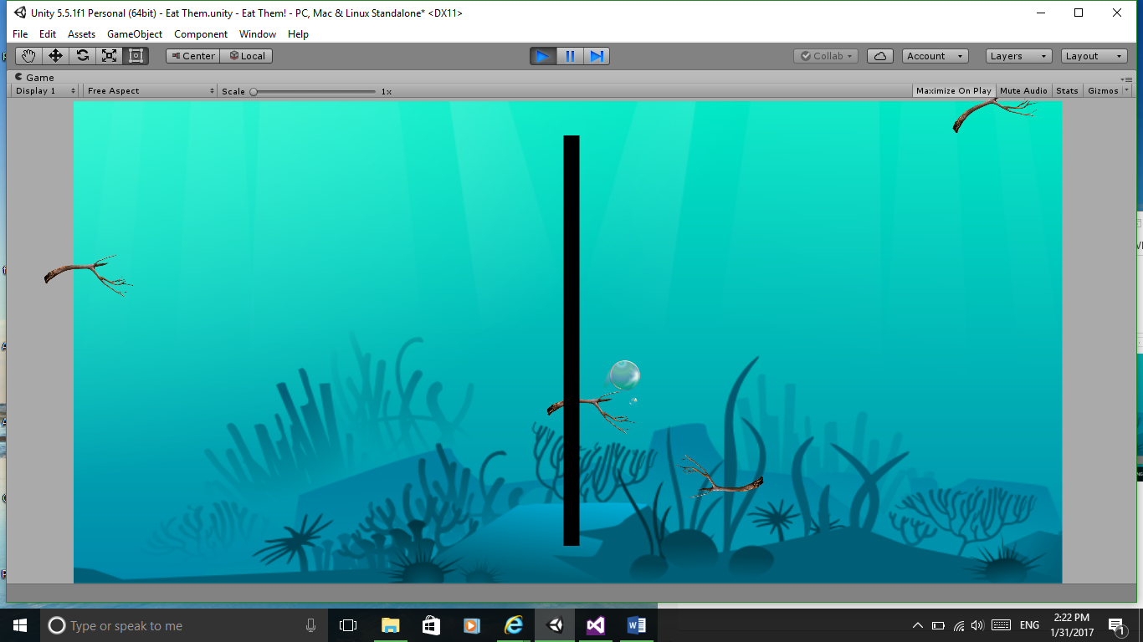
Prototype

Slide 12
Playtest Feedback
Question 1
Question 2
Question 3
Question 4

Slide 13
Management
Hours logged:
George:
Heidi:
Macaulay:

Slide 14
Next
Finalising mechanics
Playtesting to balance
Playtest to see if mechanics are evoking emotional responses
Sounds
Assurances/Feedback

Slide 15
Questions?

